Slide 1
Web Search and Mining
Lecture 13: Matrix Factorization and Latent Semantic Indexing

Slide 2
Topic
Matrix factorization = matrix decomposition
Latent Semantic Indexing (LSI)
  Term-document matrices are very large
  But the number of topics that people talk about is small (in some sense)
    Clothes, movies, politics, …
  Can we represent the term-document space by a lower dimensional latent space?

Slide 3
Linear Algebra Background
Background

Slide 4

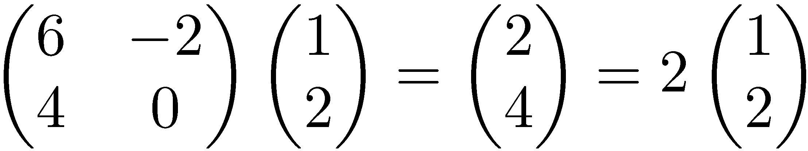
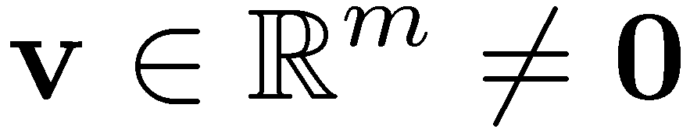
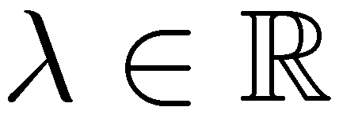
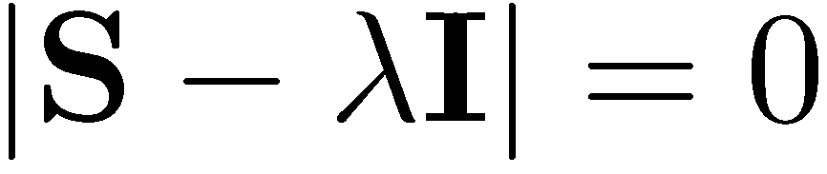
Eigenvalues & Eigenvectors
Background
Eigenvectors (for a square m×m matrix S)
How many eigenvalues are there at most?
Example
(right) eigenvector
eigenvalue
only has a non-zero solution if
This is a mth order equation in λ which can have at most m distinct solutions (roots of the characteristic polynomial) – can be complex even though S is real.

Slide 5
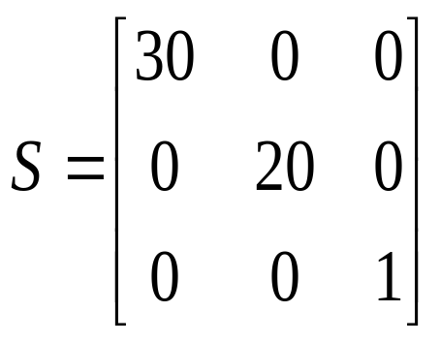
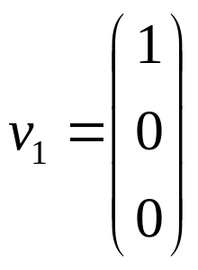
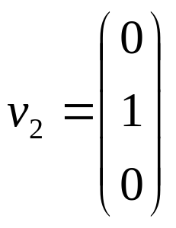
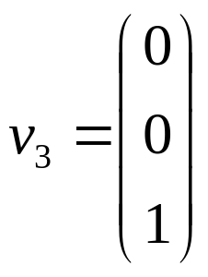

Matrix-vector multiplication
Background
has eigenvalues 30, 20, 1 with
corresponding eigenvectors
On each eigenvector, S acts as a multiple of the identity
matrix: but as a different multiple on each.
Any vector (say x= ) can be viewed as a combination of
the eigenvectors: x = 2v₁ + 4v₂ + 6v₃

Slide 6
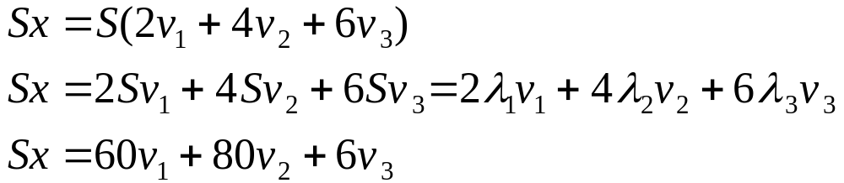
Matrix vector multiplication
Background
Thus a matrix-vector multiplication such as Sx (S, x as in the previous slide) can be rewritten in terms of the eigenvalues/vectors:
Even though x is an arbitrary vector, the action of S on x is determined by the eigenvalues/vectors.

Slide 7
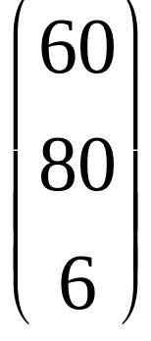
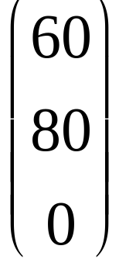
Matrix vector multiplication
Background
Suggestion: the effect of “small” eigenvalues is small.
If we ignored the smallest eigenvalue (1), then instead of
we would get
These vectors are similar (in cosine similarity, etc.)

Slide 8
Eigenvalues & Eigenvectors
Background
For symmetric matrices, eigenvectors for distinct
eigenvalues are orthogonal
  All eigenvalues of a real symmetric matrix are real.
All eigenvalues of a positive semidefinite matrix
are non-negative

Slide 9
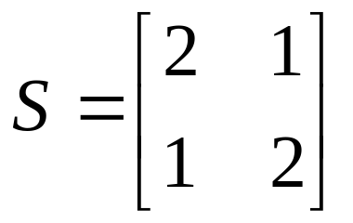
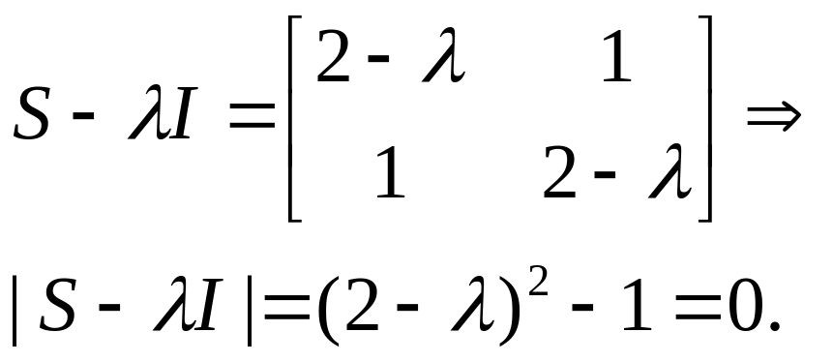
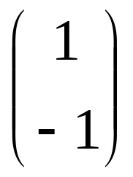
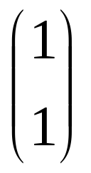
Example
Background
Let
Then
The eigenvalues are 1 and 3 (nonnegative, real).
The eigenvectors are orthogonal (and real):
Real, symmetric.
Plug in these values and solve for eigenvectors.

Slide 10
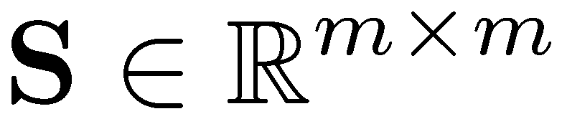
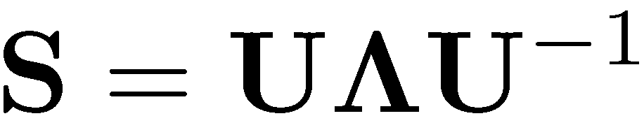
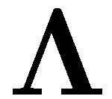

Eigen/diagonal Decomposition
Background
Let be a square matrix with m linearly independent eigenvectors (a “non-defective” matrix)
Theorem: Exists an eigen decomposition
  (cf. matrix diagonalization theorem)
Columns of U are eigenvectors of S
Diagonal elements of are eigenvalues of
Unique for distinct eigen-values
diagonal

Slide 11
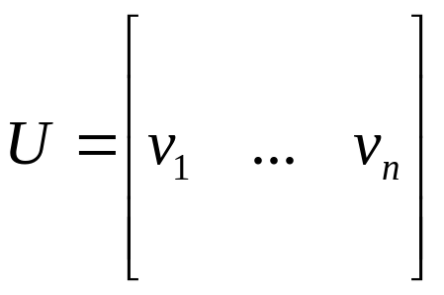
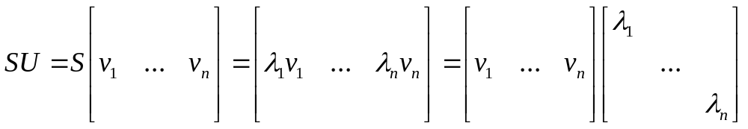
Diagonal decomposition: why/how
Background
Let U have the eigenvectors as columns:
Then, SU can be written
Thus SU=UΛ, or U^{–1}SU=Λ
And S=UΛU^{–1}.

Slide 12
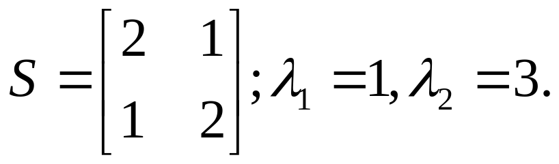
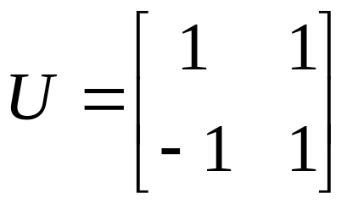
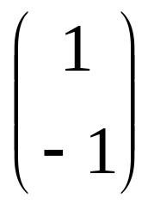
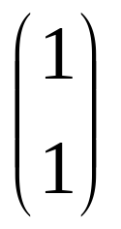
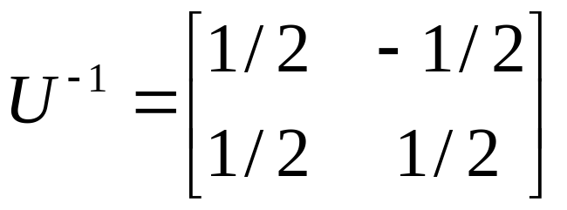
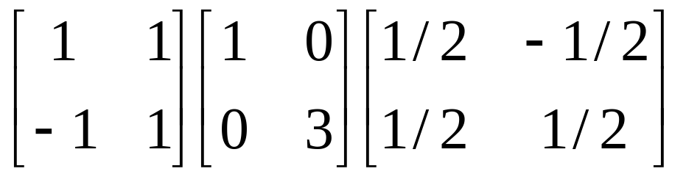
Diagonal decomposition - example
Background
Recall
The eigenvectors and form
Recall
UU^{–1} =I.
Inverting, we have
Then, S=UΛU^{–1} =

Slide 13

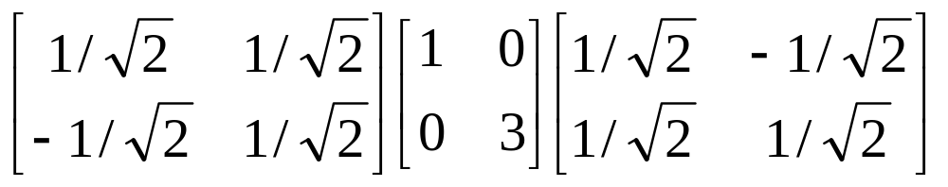
Example continued
Background
Let’s divide U (and multiply U^{–1}) by
Then, S=
Q
Λ
(Q⁻¹= Q^{T} )
Why? Stay tuned …

Slide 14
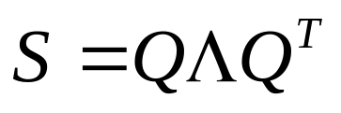
Symmetric Eigen Decomposition
Background
If is a symmetric matrix:
Theorem: There exists a (unique) eigen decomposition
where Q is orthogonal:
  Q⁻¹= Q^{T}
  Columns of Q are normalized eigenvectors
  Columns are orthogonal.
  (everything is real)

Slide 15
Time out!
I came to this class to learn about web search and mining, not have my linear algebra past dredged up again …
  But if you want to dredge, Strang’s Applied Mathematics is a good place to start.
What do these matrices have to do with text?
Recall M × N term-document matrices …
But everything so far needs square matrices – so …

Slide 16
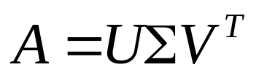
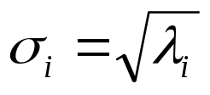
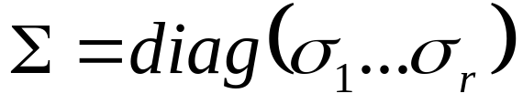
Singular Value Decomposition
SVD
For an M × N matrix A of rank r there exists a
factorization (Singular Value Decomposition = SVD)
as follows:
M×M
M×N
V is N×N
The columns of U are orthogonal eigenvectors of AA^{T}.
The columns of V are orthogonal eigenvectors of A^{T}A.
Eigenvalues λ₁ … λ_{r} of AA^{T} are the eigenvalues of A^{T}A.
Singular values.

Slide 17
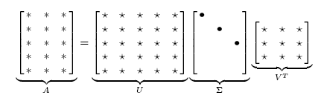
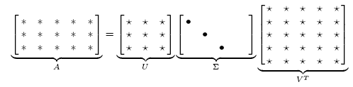
Singular Value Decomposition
SVD
Illustration of SVD dimensions and sparseness

Slide 18
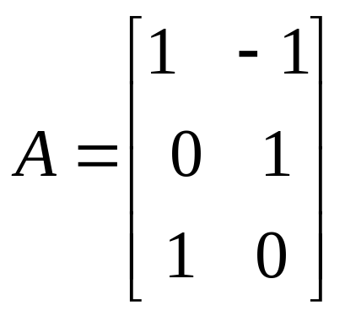
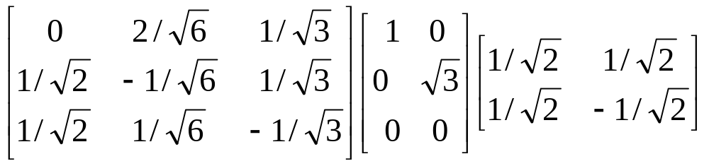
SVD example
SVD
Let
Thus M=3, N=2. Its SVD is
Typically, the singular values arranged in decreasing order.

Slide 19
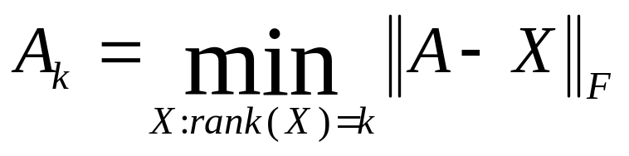

Low-rank Approximation
Low-Rank Approximation
SVD can be used to compute optimal low-rank approximations.
Approximation problem: Find A_{k} of rank k such that
A_{k} and X are both m×n matrices.
Typically, want k << r.
Frobenius norm

Slide 20
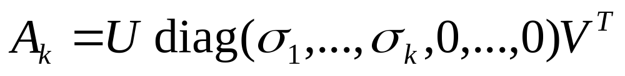
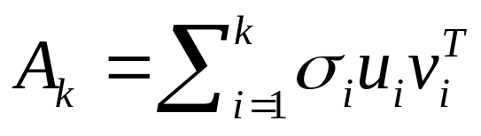
Low-rank Approximation
Low-Rank Approximation
Solution via SVD
set smallest r-k
singular values to zero
k
column notation: sum
of rank 1 matrices

Slide 21
Reduced SVD
Low-Rank Approximation
If we retain only k singular values, and set the rest to 0, then we don’t need the matrix parts in brown
Then Σ is k×k, U is M×k, V^{T} is k×N, and A_{k} is M×N
This is referred to as the reduced SVD
It is the convenient (space-saving) and usual form for computational applications
It’s what Matlab gives you
k

Slide 22
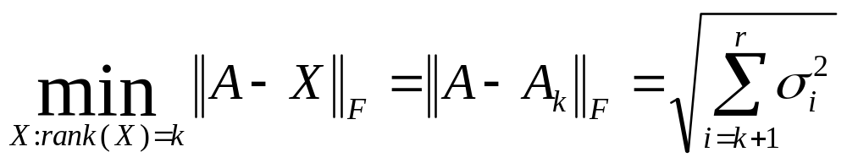
Approximation error
Low-Rank Approximation
How good (bad) is this approximation?
It’s the best possible, measured by the Frobenius norm of the error:
where the σ_{i} are ordered such that σ_{i} ≥ σ_{i+1}.
Suggests why Frobenius error drops as k increased.

Slide 23
SVD Low-rank approximation
Low-Rank Approximation
Whereas the term-doc matrix A may have M=50000, N=10 million (and rank close to 50000)
We can construct an approximation A₁₀₀ with rank 100.
  Of all rank 100 matrices, it would have the lowest Frobenius error.
Great … but why would we??
Answer: Latent Semantic Indexing
C. Eckart, G. Young, The approximation of a matrix by another of lower rank. Psychometrika, 1, 211-218, 1936.

Slide 24
Latent Semantic Indexing via the SVD
LSI

Slide 25
What it is
LSI
From term-doc matrix A, we compute the approximation A_{k.}
There is a row for each term and a column for each doc in A_{k}
Thus docs live in a space of k<<r dimensions
  These dimensions are not the original axes
But why?

Slide 26
Vector Space Model: Pros
LSI
Automatic selection of index terms
Partial matching of queries and documents (dealing with the case where no document contains all search terms)
Ranking according to similarity score (dealing with large result sets)
Term weighting schemes (improves retrieval performance)
Various extensions
  Document clustering
  Relevance feedback (modifying query vector)
Geometric foundation

Slide 27
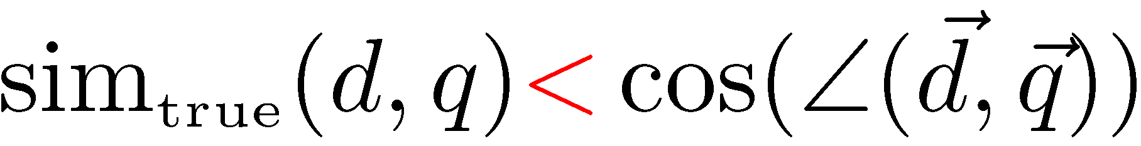
Problems with Lexical Semantics
LSI
Ambiguity and association in natural language
  Polysemy: Words often have a multitude of meanings and different types of usage (more severe in very heterogeneous collections).
  The vector space model is unable to discriminate between different meanings of the same word.

Slide 28
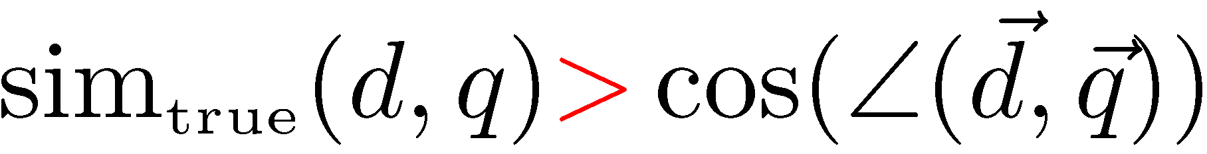
Problems with Lexical Semantics
LSI
  Synonymy: Different terms may have an identical or a similar meaning (weaker: words indicating the same topic).
  No associations between words are made in the vector space representation.

Slide 29
Polysemy and Context
LSI
Document similarity on single word level: polysemy and context
ring
jupiter
•••
space
voyager
meaning 1
…
planet
...
…
saturn
...
meaning 2
car
company
•••
dodge
ford
contribution to similarity, if used in 1st meaning, but not if in 2nd

Slide 30
Latent Semantic Indexing (LSI)
LSI
Perform a low-rank approximation of document-term matrix (typical rank 100-300)
General idea
  Map documents (and terms) to a low-dimensional representation.
  Design a mapping such that the low-dimensional space reflects semantic associations (latent semantic space).
  Compute document similarity based on the inner product in this latent semantic space

Slide 31
Goals of LSI
LSI
Similar terms map to similar location in low dimensional space
Noise reduction by dimension reduction

Slide 32
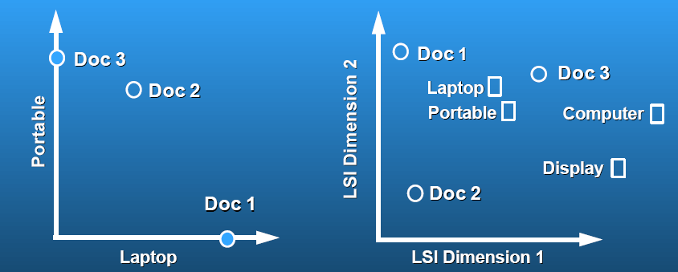
Latent Semantic Analysis
LSI
Latent semantic space: illustrating example
courtesy of Susan Dumais

Slide 33
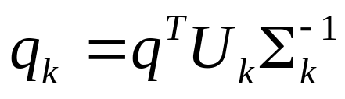
Performing the maps
LSI
Each row and column of A gets mapped into the k-dimensional LSI space, by the SVD.
Claim – this is not only the mapping with the best (Frobenius error) approximation to A, but in fact improves retrieval.
A query q is also mapped into this space, by
  Query NOT a sparse vector.

Slide 34
Empirical evidence
LSI
Experiments on TREC 1/2/3 – Dumais
Lanczos SVD code (available on netlib) due to Berry used in these expts
  Running times of ~ one day on tens of thousands of docs [still an obstacle to use]
Dimensions – various values 250-350 reported. Reducing k improves recall.
  (Under 200 reported unsatisfactory)
Generally expect recall to improve – what about precision?

Slide 35
Empirical evidence
LSI
Precision at or above median TREC precision
  Top scorer on almost 20% of TREC topics
Slightly better on average than straight vector spaces
Effect of dimensionality:
Dimensions | Precision
250 | 0.367
300 | 0.371
346 | 0.374

Slide 36
But why is this clustering?
LSI
We’ve talked about docs, queries, retrieval and precision here.
What does this have to do with clustering?
Intuition: Dimension reduction through LSI brings together “related” axes in the vector space.

Slide 37
Intuition from block matrices
LSI
N documents
Block 1
What’s the rank of this matrix?
Block 2
0’s
M
terms
…
0’s
Block k
= Homogeneous non-zero blocks.

Slide 38
Intuition from block matrices
LSI
N documents
Block 1
Block 2
0’s
M
terms
…
0’s
Block k
Vocabulary partitioned into k topics (clusters); each doc discusses only one topic.

Slide 39
Intuition from block matrices
LSI
N documents
Block 1
What’s the best rank-k
approximation to this matrix?
Block 2
0’s
M
terms
…
0’s
Block k
= non-zero entries.

Slide 40
Intuition from block matrices
LSI
Likely there’s a good rank-k
approximation to this matrix.
wiper
Block 1
tire
V6
Block 2
Few nonzero entries
…
Few nonzero entries
Block k
car
1
0
automobile
0
1

Slide 41
Simplistic picture
LSI
Topic 1
Topic 2
Topic 3

Slide 42
Some wild extrapolation
LSI
The “dimensionality” of a corpus is the number of distinct topics represented in it.
More mathematical wild extrapolation:
  if A has a rank k approximation of low Frobenius error, then there are no more than k distinct topics in the corpus.

Slide 43
LSI has many other applications
LSI
In many settings in pattern recognition and retrieval, we have a feature-object matrix.
  For text, the terms are features and the docs are objects.
  Could be opinions and users …
  This matrix may be redundant in dimensionality.
  Can work with low-rank approximation.
  If entries are missing (e.g., users’ opinions), can recover if dimensionality is low.
Powerful general analytical technique
  Close, principled analog to clustering methods.

Slide 44
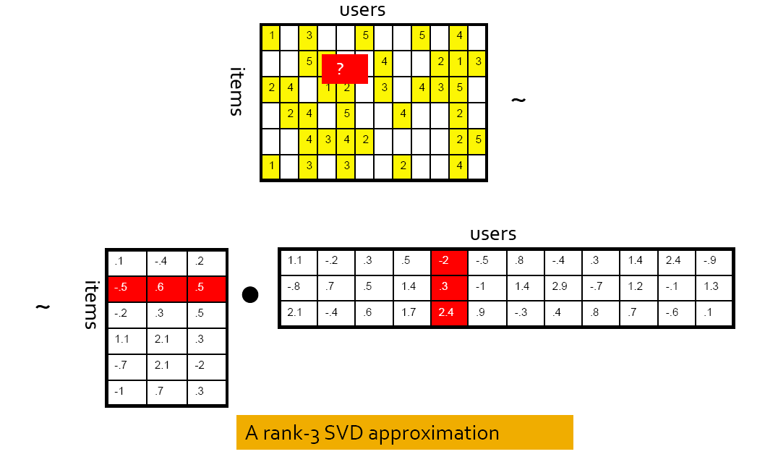
Recommender Systems

Slide 45
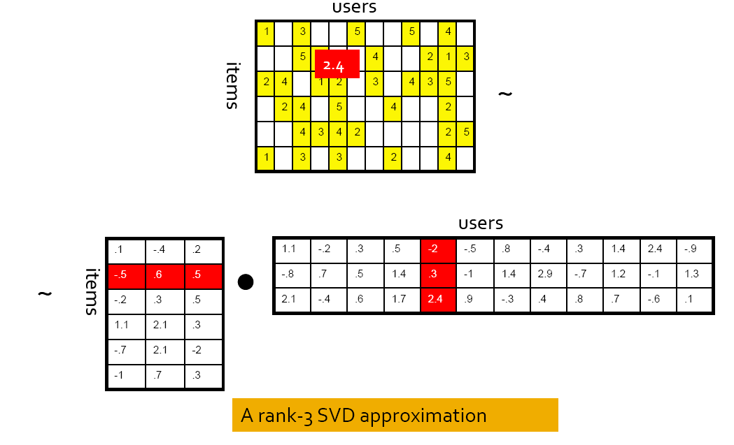
Recommender Systems

Slide 46
Other matrix factorization methods
Non-negative matrix factorization
  Daniel D. Lee and H. Sebastian Seung (1999). Learning the parts of objects by non-negative matrix factorization. Nature 401 (6755): 788–791.
Joint (collective) matrix factorization
  A.P. Singh & G.J. Gordon. Relational Learning via Collective Matrix Factorization. Proc. 14th ACM SIGKDD Intl. Conf. on Knowledge Discovery and Data Mining, 2008.
Relation regularized matrix factorization
  Wu-Jun Li, Dit-Yan Yeung. Relation Regularized Matrix Factorization. IJCAI 2009: 1126-1131.

Slide 47
Resources
IIR 18

